Slide 1
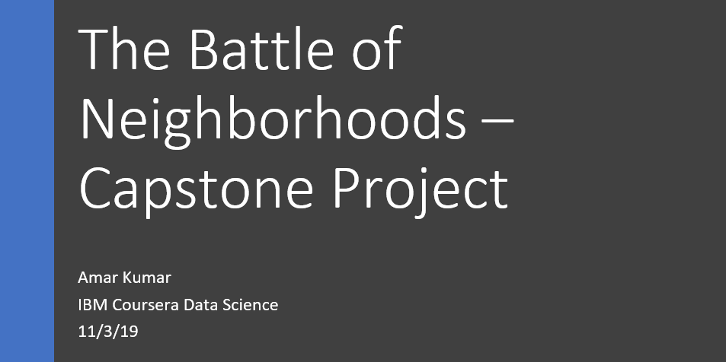

Slide 2
INDEX
Business Problem
Introduction
Data
Methodology
Results
Discussions
Conclusions

Slide 3
Business Problem:
Let’s say we have a client who’s interested in opening an Indian restaurant in New York city and is also planning to branch out into the surrounding boroughs. The client wants to start small but is expecting to generate very good profits so that could boost the confidence besides profits made, to set up another branch. Given that New York city is vast and the presence of many top, aggressive competitors, the client wants us to analyze the neighborhoods and analyze competitors and the areas that could help in the process of making business decisions as to where to start off for making very good profits and where to branch out next.

Slide 4
Introduction:
New York City’s demographics show that it is a large and ethnically diverse metropolis. It is the largest city in the United States with a long history of international immigration. New York City was home to nearly 8.5 million people in 2014, accounting for over 40% of the population of New York State and a slightly lower percentage of the New York metropolitan area, home to approximately 23.6 million. Over the last decade the city has been growing faster than the region. The New York region continues to be by far the leading metropolitan gateway for legal immigrants admitted into the United States.
According to 2007 American Community Survey estimates, New York City is home to approximately 236,117 people from the India. With its diverse culture, comes diverse food items. There are many restaurants in New York City, each belonging to different categories like Chinese, Indian, French etc.
We will analyze all major parts of New York City that has Indian restaurants and try to figure out what business decisions and strategies could be made for our client, to set up an Indian restaurant and expand business.

Slide 5
Data:
We will be utilizing the following data:
New York City dataset in the form of JSON file that contains list Boroughs, Neighborhoods along with their latitude and longitude. We will need to convert it to a dataframe and extract all the necessary attributes such as Neighborhood, Borough, Coordinates etc.
Data source: https://cocl.us/new_york_dataset
A list of Indian Restaurants in each neighborhood of New York city. By using the Foursquare API, we will fetch the venues in each neighborhood. We can filter these venues to get only the list of Indian Restaurants and analyze as per the neighborhoods. We then also extract the ratings of the respective venues to figure out the competitors’ reputation and quality of food or service using Foursqaure’s premium API calls. We finally put the results together from both the analysis and come up possible business decisions to be proposed to the client.
Data source: Foursquare API calls.

Slide 6
Methodology:
We will extract restaurant venues as per the neighborhoods, analyze their ratings and also visualize them on the map to see that distribution of the places in respective boroughs and make business decisions based on the final results.
We have imported all the necessary libraries for geocoding of given address to get coordinates, folium maps to shown and finally Foursquare credentials to be used to fetch the venues and their details.
We extracted only necessary details such as neighborhood, borough and their coordinates etc., from the json file of the city data.
We have extracted a list of venues in the specified radius by the client for each coordinate of the neighborhood with a certain limit.
We have filtered out the category of the venues fetched to be ‘Indian Restaurant’ to suit our requirements for further analysis.
We have gotten 151 Indian Restaurants in NY, and checked out the distribution with respect to boroughs and neighborhoods.
After fetching all the ratings of Indian Restaurants for the NY city, let's say that the client has decided to check results for a strategy which is by assuming that setting up a new restaurant in a place where the competitors aren't too many and their performance is average or less, there is a high chance that the more customers will be coming in and hence more revenue could be generated, provided that the restaurant has variety of dishes, taste and quality is better than the most.
We filtered out the results to have avg. rating <= 7.0 to visualize and figure out our results to make business decisions.
Analysis was made to see the distribution of the venues in the city in various ways.

Slide 7
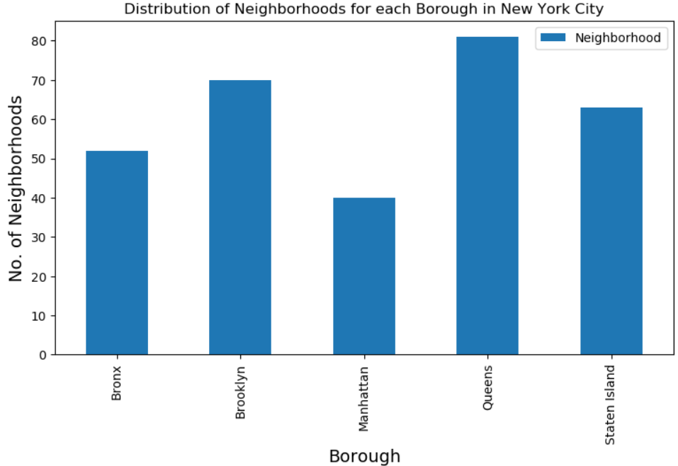
Results:
We can see that Brooklyn, Queens and Bronx could be a very good start for our client to gain popularity and revenue with a new restaurant there. After a certain amount of time, with sufficient funds, the client can look forward to branch out more restaurants in other neighborhoods and boroughs.
We can see that Queens has highest number of neighborhoods as below.

Slide 8
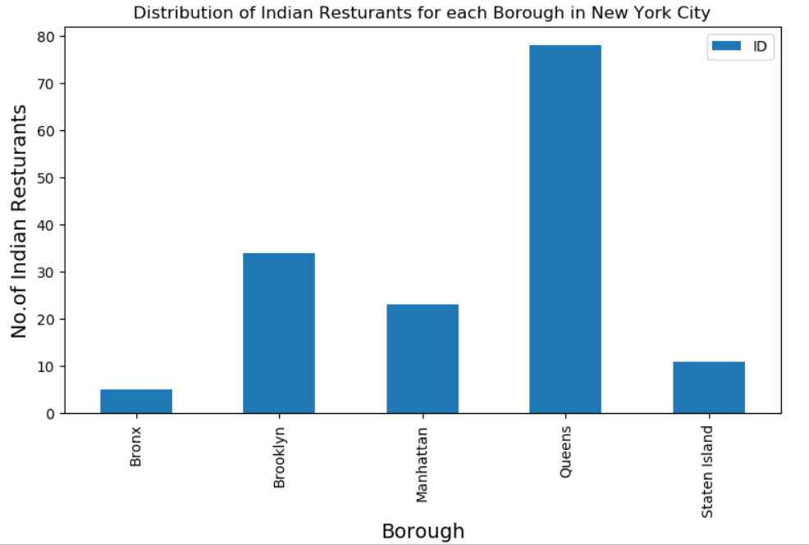
Queens has the highest number of Indian restaurants in it’s neighborhoods.

Slide 9
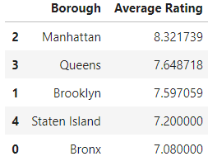
By finding the averge of ratings borough wise, we find that Manhattan seems to have highest number of restaurants with very good ratings, his would mean that there are top and aggressive competitors in that borough and would not be a very good start for our client to start setting up in Manhattan and gain popularity among customers and generate good revenue. On the other hand, the client can still check out other boroughs and neighborhoods accordingly to see where would be a great start for the restaurant and branch out later on.

Slide 10
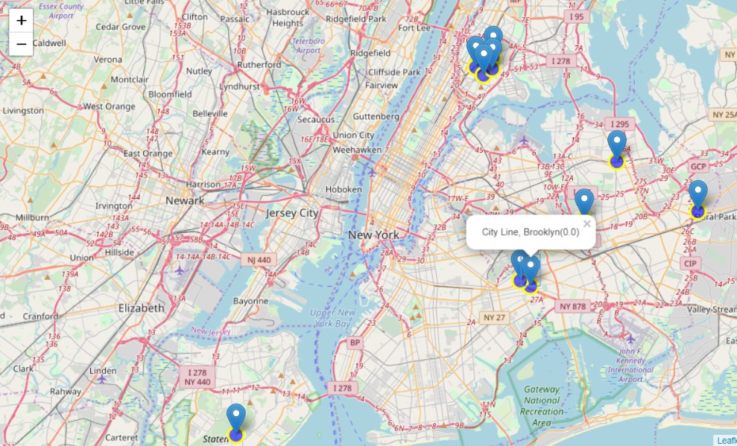
After analysing the boroughs for avg. ratings of restaurants to be <= 7.0, we find out that Queens, Brooklyn and Bronx could be a very good start to set up a new Indian restaurant and attract customers and gain popularity since they seem to have a bit less number of restaurants and lesser ratings, which means competition is tolerable in those areas.

Slide 11
Discussions:
We may notice that the Staten Island has very restaurants and very less ratings which may mean either new restaurants exist and not yet rated or recorded in Foursquare database or the residents aren’t really into Indian cuisine.
We may have missed out on potential competitors in other boroughs too by the probability that they're new and haven't been rated or recorded in Foursquare database.

Slide 12
Conclusions:
We can see that Brooklyn, Queens and Bronx could be a very good start for our client to gain popularity and revenue with a new restaurant there. After a certain amount of time, with sufficient funds, the client can look forward to branch out more restaurants in other neighborhoods and boroughs. The client will now have enough data and insights to make a move and expand restaurant business and popularity.

